Slide 1
CSE 326
UniForum Mock UI
Section : A2
Group: 1
1805018 - Md. Rownak Sahanawaz
(Presenter) 1805031 - Nahian Shabab
1805043 - Arup Debnath
1805044 - Md. Misbahul Hasan
1805059 - Md. Mehedi Al Masud
1805060 - Shamim Al-Mamun

Slide 2
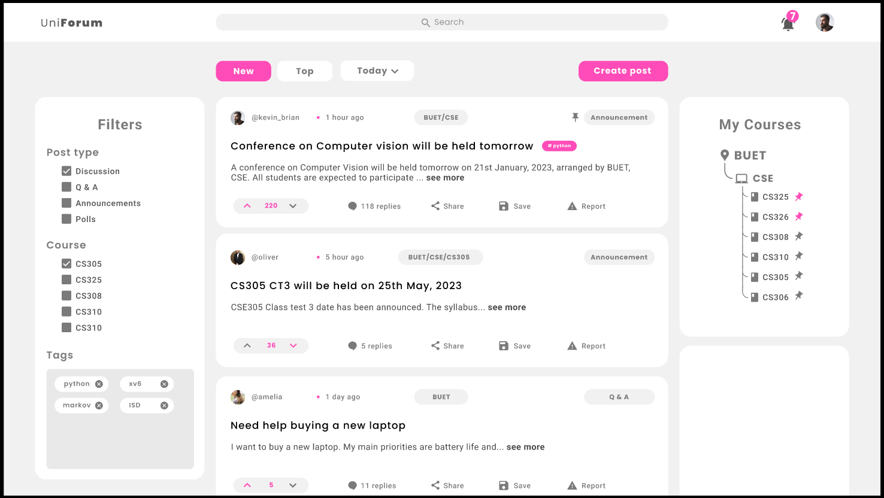
Home
Notes:
Home

Slide 3
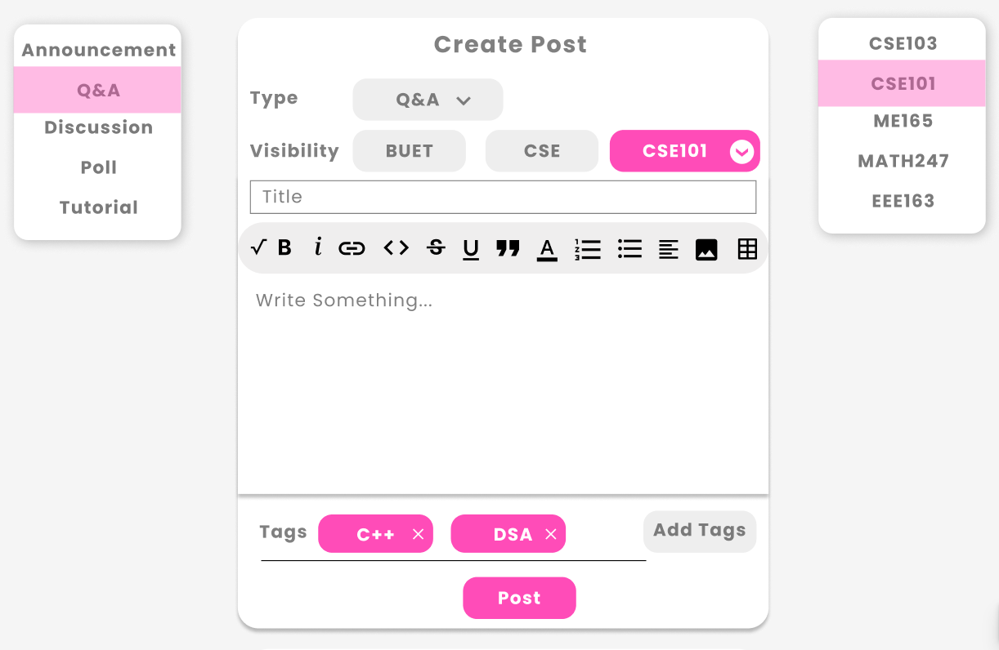
Post Creation

Slide 4
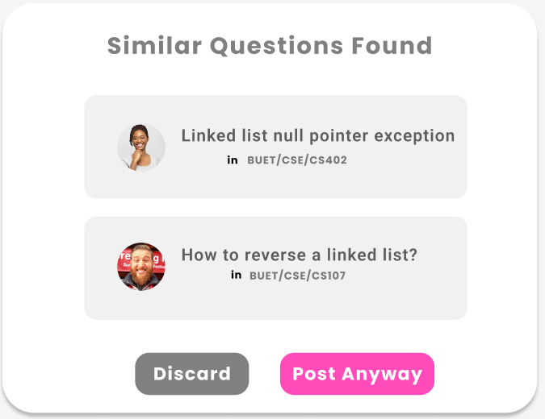
Similar Question

Slide 5
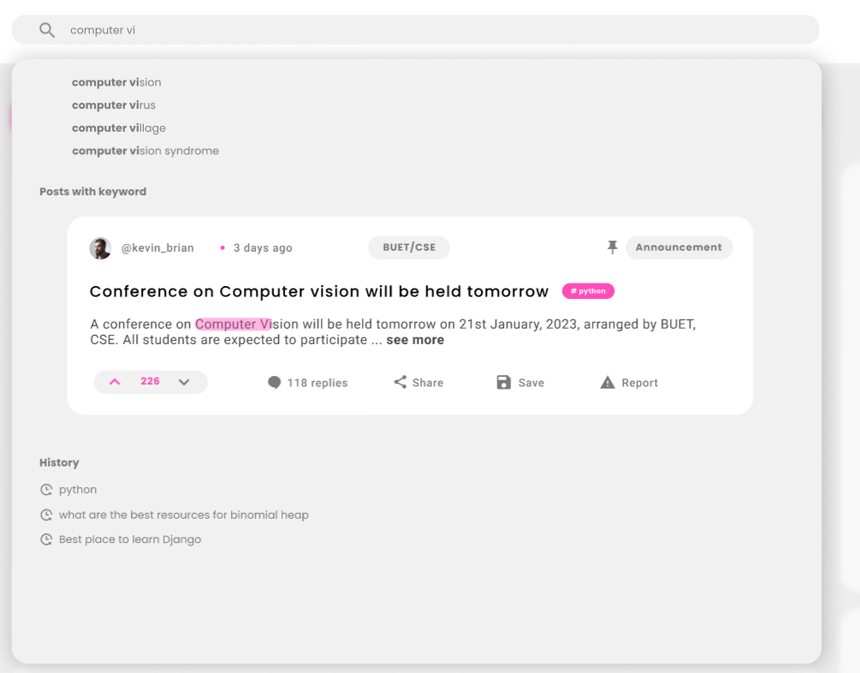
Searching

Slide 6
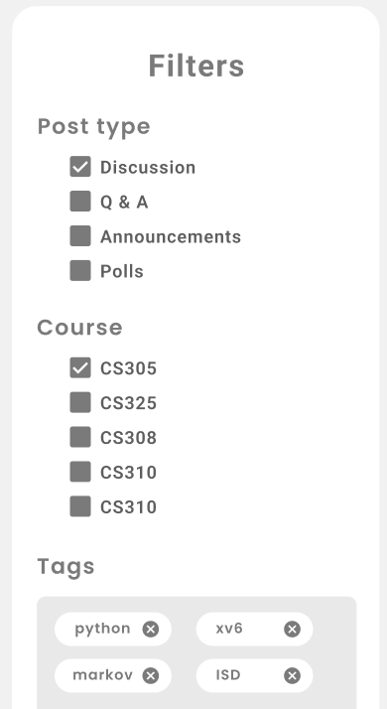


Filtering and Sorting

Slide 7
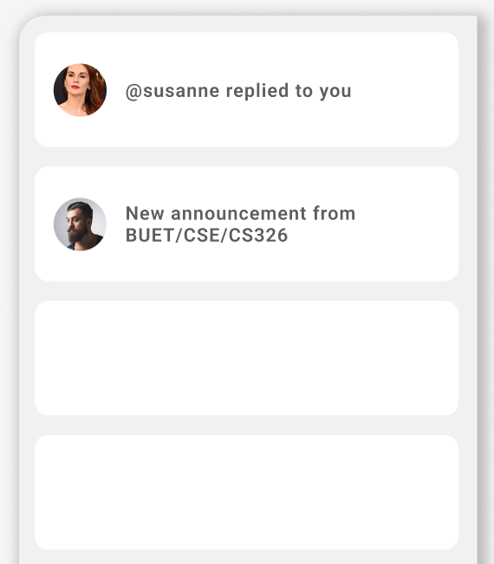
Notification

Slide 8
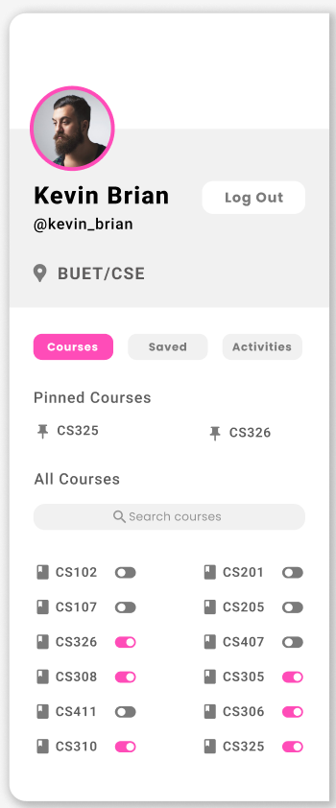
Profile : Courses

Slide 9
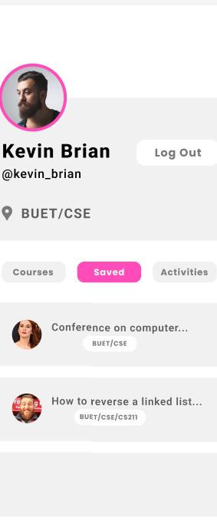
Profile : Saved

Slide 10
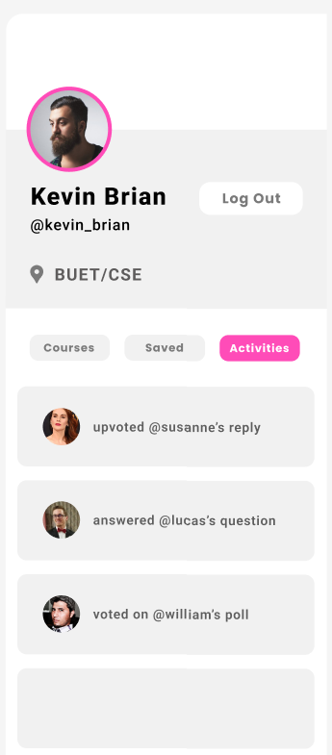
Profile : Saved

